Slide 1
Ordinary Differential Equations
PHYS3112 – Tutorial 3

Slide 2
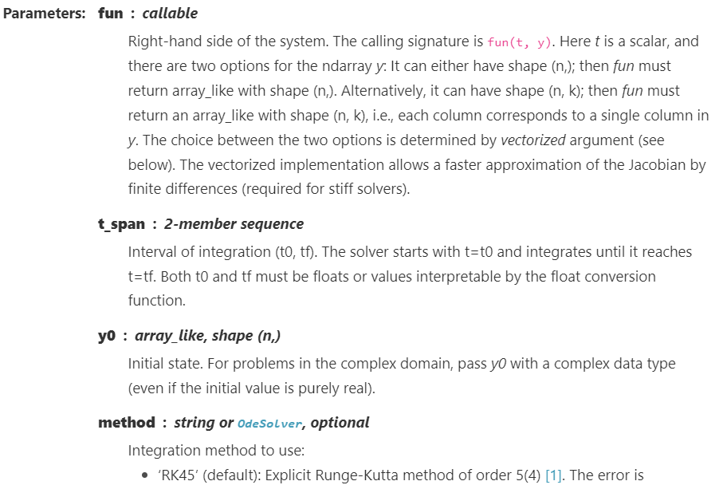
What is solve_ivp?
Solve Initial Value Problem for Ordinary Differential Equations, basically it integrates a certain function ‘func’ that we give it.
The hardest part is writing the func

Slide 3

Writing your solv_ivp-able function
Your function / derivative COULD depend on time (t), or it could depend on the current status of the system (y).
It’s inputs must be t, y and then other arguments.
‘y’ can be a vector, meaning it can actually be a variable containing many values
It must return the set of dy/dt (i.e. one derivative for each ‘y’ we have input)’
y
FUNC
dy/dt
t

Slide 4
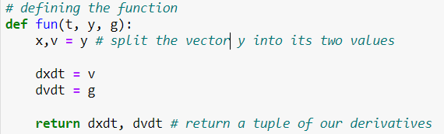
What about – two variables?
Use a tuple / vector!
Simply provide two initial values in the y vector instead of one.
Inside the function, extract the two variables from y vector (eg x, v = y)
Make sure your function returns two derivatives if you’re using two variables (and that they’re in the correct order!)

Slide 5
What about – extra parameters?
Pass them after the other variables: solve_ivp(func, [t0,tf], y, args=(,))
In the function, all variables after y will be taken from args in the order given.

Slide 6
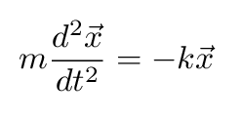

Normal Form Functions
Solve_ivp can only handle first derivatives. If you have something with a second derivative, you need to make it into first-derivative only form. We normally do this by introducing intermediate variables.
For example, the simple harmonic oscillator;
We would define v = dx/dt and express this equation as two equations using both x and v:

